Slide 1
IMAGE FORENSICS
USING
META DATA
Done By:
Raja
Ankith

Slide 2
INTRODUCTION
What is Image Forensics?
A field of digital forensics that involves analyzing images to detect tampering, authenticate sources, and gather evidence.
Importance of Metadata in Forensics.
Metadata can help trace the origin of an image, determine if it has been tampered with, and provide essential clues in criminal investigations.

Slide 3
PROBLEM STATEMENT
Challenges:
Manual analysis of metadata is time-consuming and error-prone.
Growing need for automated methods to detect suspicious patterns.
Objective:
Metadata extraction.
Leverage machine learning to detect anomalies.

Slide 4
METHODOLOGY
Meta Data Extraction
ExifRead Python library.
Extracted fields: GPS, Timestamps, Camera... etc.
2. Anomaly Detection:
Model: Isolation Forest.
Identified outliers by separating minority anomalous samples from the majority.
3. Geospatial Visualisation
We used sea-born and Folium to represent visually.

Slide 5
TECHNOLOGIES USED
Programming Language: Python
Libraries:
ExifRead for metadata extraction.
Scikit-learn for Isolation Forest model implementation.
Data Analysis Tools: Pandas, NumPy.
Visualisation Tools: Matplotlib, Seaborn, Folium

Slide 6
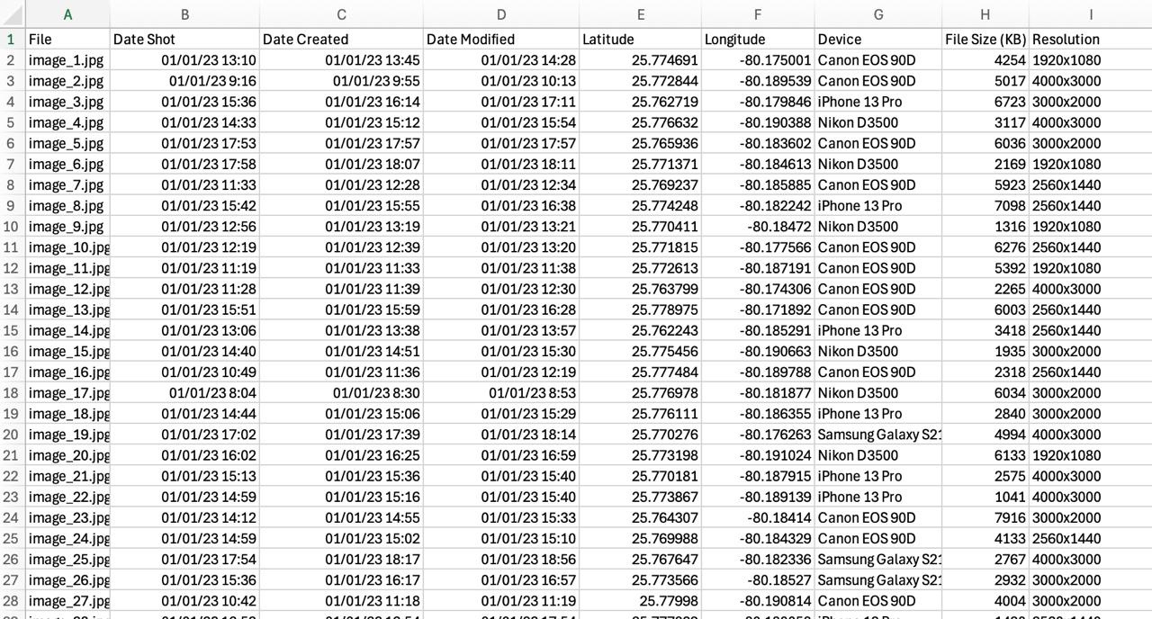
META DATA EXTRACTION
Overview:
Metadata is embedded information within image files that provides contextual and technical details.

Slide 7
Understanding Metadata:
EXIF Data (Exchangeable Image File Format):
GPS data: Latitude, longitude, altitude.
Date and time of capture.
Tool Used: ExifRead Python Library:
Reads metadata from JPEG, TIFF, and RAW image formats.
Offers structured output for easy parsing.
Example Fields Extracted:
GPSInfo: Contains geolocation data.
DateTimeOriginal: Timestamp of the original image capture.

Slide 8
FINAL DATASET

Slide 9
ANOMALY DETECTION
1. Time Difference Between Creation and Modification:
Abnormally short or long modification times can indicate suspicious activity.
2. Geospatial Information (GPS Coordinates):
Inconsistent locations may indicate misplaced evidence or tampering.
3. File Size:
Significant deviations in file size might mean compression, cropping, or editing.
4. Date Shot:
Inconsistent shooting times may indicate tampering or incorrect metadata.

Slide 10
TYPES OF ANOMALIES DETECTED
1.Time Gaps:
Red lines represent images with unusual modification intervals.
2. Out-of-Sequence Events:
Anomalies that appear out of sequence indicate suspicious changes to the timeline.
3. Location Inconsistencies:
Images with GPS data that do not match the expected crime scene location.

Slide 11
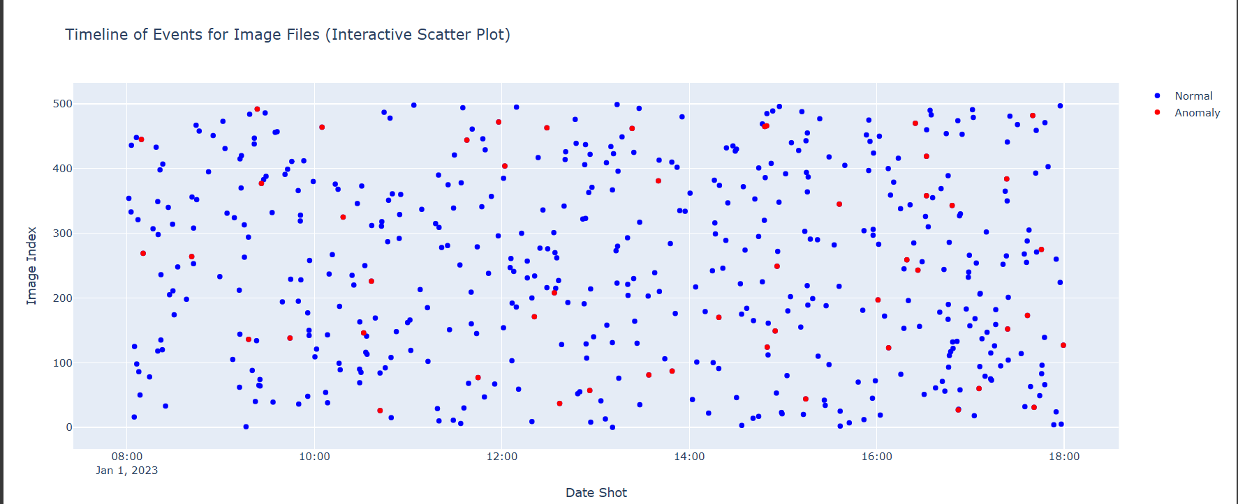
VISUAL REPRESENTATION

Slide 12
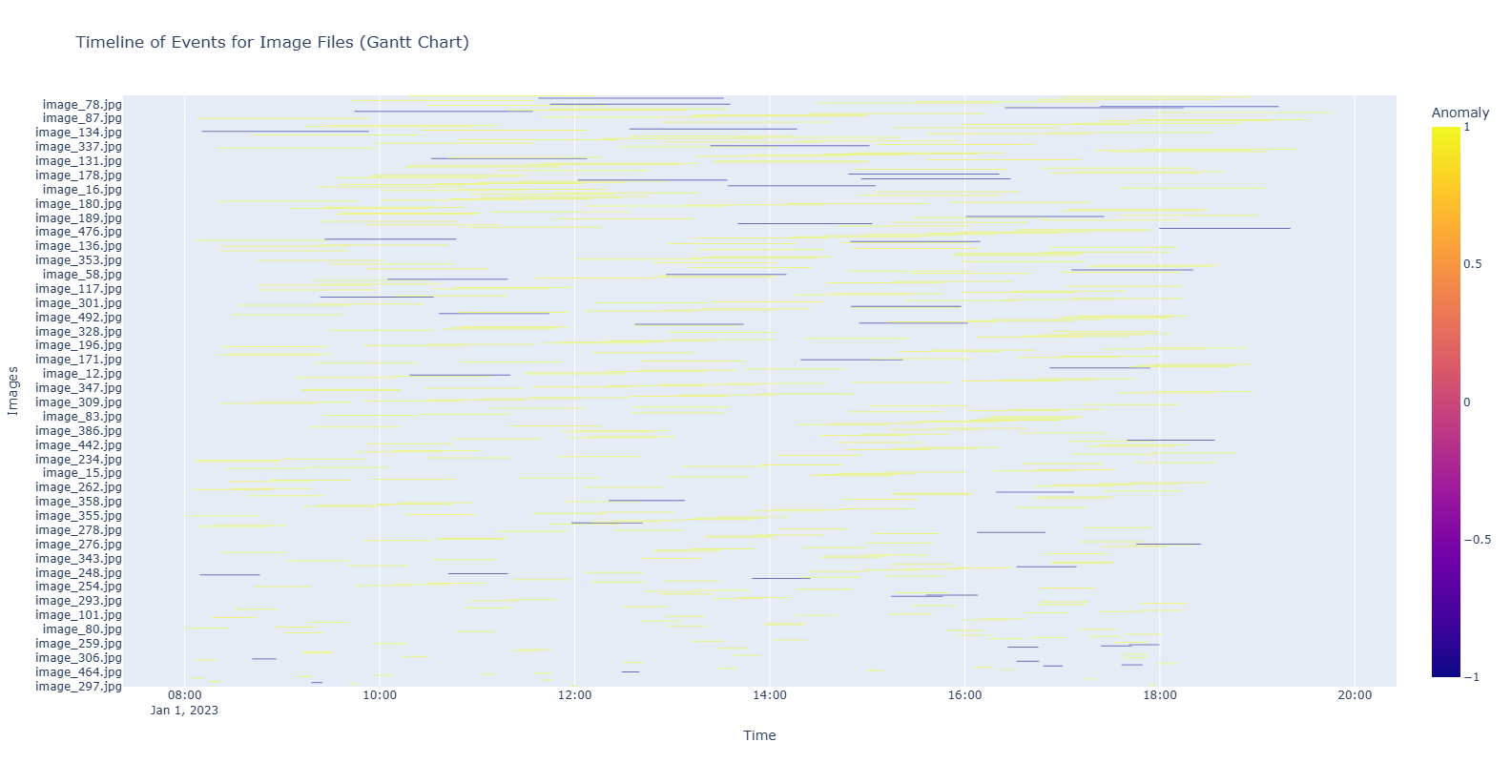
VISUAL REPRESENTATION

Slide 13
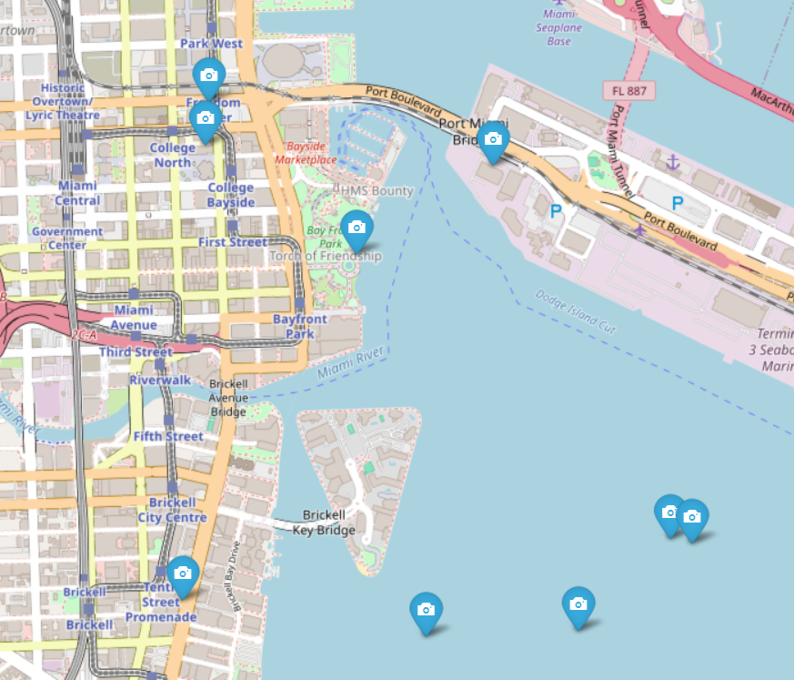
VISUAL REPRESENTATION

Slide 14
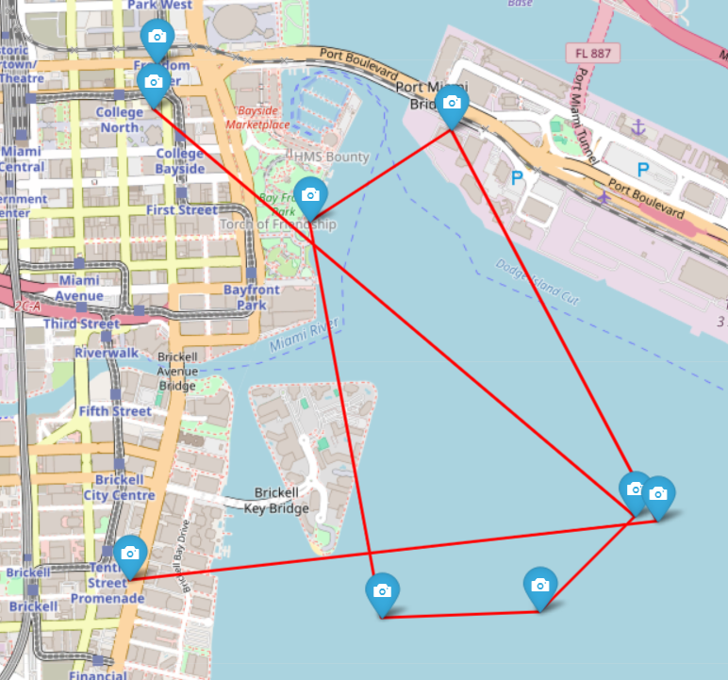
VISUAL REPRESENTATION

Slide 15
CONCLUSION
The project utilized metadata extraction, Isolation Forest for anomaly detection, and Folium for visualization to enhance image forensics in crime scene investigations. It demonstrated how combining AI and visualization tools can efficiently identify anomalies, validate evidence, and provide spatial insights, paving the way for advanced digital forensic analysis.

Slide 16
REFERENCES
[1] Sagnik Ray Choudhury et al. “Figure Metadata Extraction from Digital Documents”.
In: 2013 12th International Conference on Document Analysis and Recognition. 2013,
pp. 135–139. doi: 10.1109/ICDAR.2013.34.
[2] Runtao Liu et al. “Automatic Document Metadata Extraction Based on Deep
Networks”. In: Natural Language Processing and Chinese Computing. Ed. by
Xuanjing Huang et al. Cham: Springer International Publishing, 2018, pp. 305–317.
isbn: 978-3-319-73618-1.
[3] MA Manso et al. “Automatic metadata extraction from geographic information”. In:
7th Conference on Geographic Information Science (AGILE 2004), Heraklion, Greece.
2004, pp. 379–385.
[4] Caleb Riggs, Tanner Douglas, and Kanwalinderjit Gagneja. “Image Mapping through
Metadata”. In: 2018 Third International Conference on Security of Smart Cities,
Industrial Control System and Communications (SSIC). 2018, pp. 1–8. doi:
10.1109/SSIC.2018.8556664.
[5] Evagelos Varthis et al. “Automatic metadata extraction via image processing using
Migne’s Patrologia Graeca”. In: International Journal of Metadata, Semantics and
Ontologies 14.4 (2020), pp. 265–278.

